Slide 1
Fingerprint Sensor
Mini-Project
By Anish, Russell, Logan, Ethan

Slide 2
FINGERPRINT SENSOR
Defining Requirements, Interface, Implementation, Board Design

Slide 3
Project Definition & Project Motivation
Project Definition
Consumer Need: Fast, secure, and user-friendly authentication → convenience and privacy
Feature: Allow users to unlock the device and verify their identity with a single touch
Purpose: Personal, Modern, and Secure
Project Motivation
Project Purpose: Learn how to implement SPI and I²C communication protocols on a daughterboard
Projected Takeaways: Learn Research Process, Project Definition, Project Requirements, Decision Matrix, Part Selection, Reading Datasheet, PCB Schematic Design, PCB Editor Design, and Documentation

Slide 4
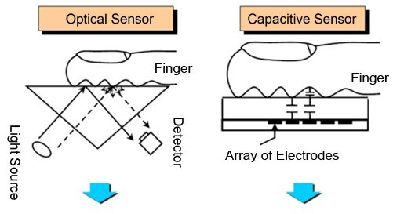
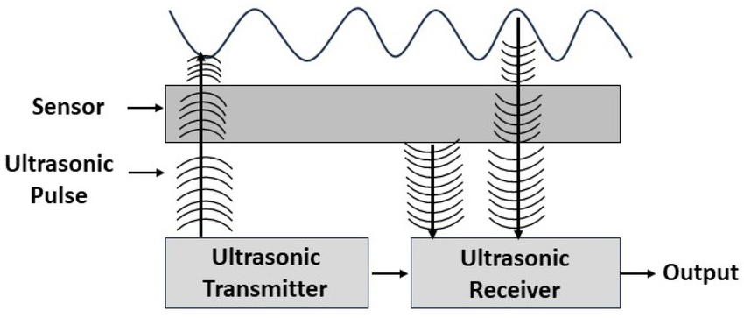
What Type of Fingerprint Sensor Should We Use?
Capacitive
Optical
Ultrasonic
Array of tiny capacitors
Detects the valleys and ridges of the fingerprint
  Measurement of difference in electrical charge.
2D data map of the fingerprint
Camera system or photodiode array
Captures an image of fingerprint
Requires a light source
Most physical space of the three
Emits ultrasonic sound waves
Penetrates the outer layer of fingerprint and bounces back
Time component
  Detailed 3D map of the fingerprint

Slide 5
What Type of Fingerprint Sensor Should We Use?
Type | Capacitive | Optical | Ultrasonic
Pros | High Accuracy Quick Smallest form factor Cost effective Low Power Consumption | Simple and easy to implement Relatively Cost Effective | Secure due to 3D detail Resistance to dirt and liquids Suitable for under screen use
Cons | Finger must be clean and dry Not suitable for under screen use | Bulky Susceptible to spoofing/Low security High power consumption | Expensive Medium power consumption Challenging integration
Our Choice:
In the end we decided to use a capacitive fingerprint sensor because of their cost effectiveness, good accuracy, small form factor, and easy implementation relative to the other types.

Slide 6
Fingerprint Sensor Type Selection Process
Type | Price (2) [1.3x] | Complexity (1) [1.5x] | Size (5) [1.0x] | Accuracy (3) [1.2x] | Effectiveness (4) [1.1x] | Power (6) [0.9x] | Total
Capacitive | 8 | 9 | 10 | 7 | 3 | 8 | 52.8
Optical | 5 | 7 | 3 | 4 | 5 | 6 | 35.7
Ultrasonic | 4 | 2 | 7 | 9 | 8 | 3 | 37.5

Slide 7
Fingerprint Sensor Selection Process
Sensor | Protocol | Complexity | Accuracy | Power Consumption | Pixel Size | Sensor Area | Special Features | Total Score
FPC1030 | LVDS | 3 | 6 | 9 | 6 | 9 | Swipe, Ultra-low power, >15kV ESD | 42
FPC2532AP | I2C, SPI, UART, USB | 7 | 8 | 7 | 7 | 7 | IP67 water/dust, deep sleep/wake, onboard encryption | 51
FPC1020 | SPI | 8 | 9 | 8 | 9 | 6 | 508 dpi, durable coating, IP-rating, fast touch sensing | 49
FPC1020 CMOS | UART | 6 | 7 | 7 | 8 | 6 | Simple serial interface, good for embedded security use | 41

Slide 8
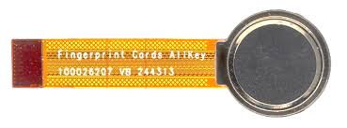
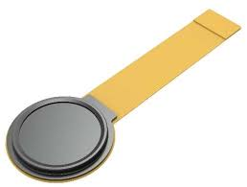
Sensor Selection Process (FPC2532AP)
Common Sensor Specifications
  3.0 - 3.6V operating voltage
  17 - 21 mA operating current
  100x96 pixels, 508 dpi
  Ø 11 mm × 0.83 mm thickness
FPC2530 Specifications
  $25.30 (Digikey)
  SPI up to 10 MHz
  I²C up to 400kbit/s
  Fast response: 150ms boot, 0.5 ms wake-from-sleep, 130ms capture time
  22µA sleep-mode current
  IP67 dust and water resistant

Slide 9
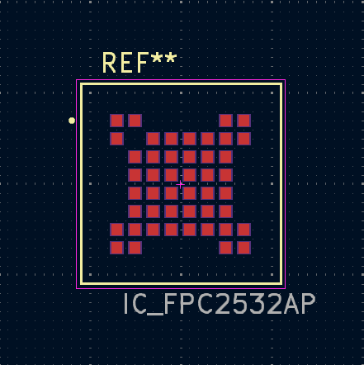
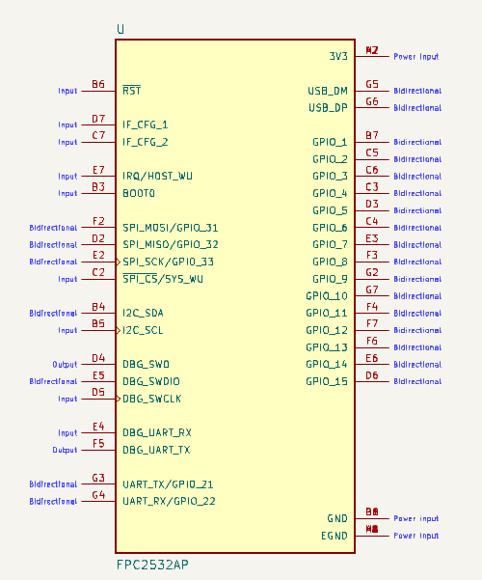

Slide 10
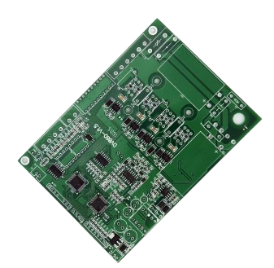
Our Requirements
Pressure Range
  1009.1438226666767 hPa - 1022.6893773333434 hPa (inside)
  300–1100 hPa to handle all GPS- and altitude-related application (outside)
Accuracy: ± 1.0 hPa and ± 0.5°C
Interface of Choice: I²C
  Analog
    Transmits continuous voltage signals that directly represent a physical quantity, such as temperature or light intensity. Analog sensors output a voltage proportional to the measured value, which the receiving system interprets through an analog-to-digital converter (ADC). This method uses one wire per sensor signal and requires careful calibration due to noise and voltage scaling.
  SPI
    Transfers data between a single master and one or more slave devices using four wires: serial clock (SCLK), master-out-slave-in (MOSI), master-in-slave-out (MISO), and chip select (CS). SPI is a high-speed, full-duplex protocol ideal for fast communication with peripherals like sensors, displays, or memory chips. Each slave device needs its own CS line.
  I²C
    Transfer data between a master (or multiple masters) and a single slave (or multiple slaves) device. It is a bidirectional two-wire serial bus that uses serial clock (SCL) and serial data (SDA) wires to send and manage data bit by bit between devices connected to the bus.
  UART
    Transfers data between two devices over two wires (TX for transmit, RX for receive) without needing a clock signal. UART uses start and stop bits to frame each data byte and requires both devices to agree on a communication speed (baud rate). It supports full-duplex communication but is limited to point-to-point connections (one-to-one).
Power Supply: 3.3V
Form Factor: Compact, aligns with daughterboard header
Notes:
✅ Why We Chose I²C for the Thermometer Module
1. 🧩 Multiple Sensors on One Bus
Your system includes more than one sensor (e.g., thermometer + barometer).
I²C supports multiple devices on the same two wires—each with a unique address.
This simplifies wiring and PCB routing, especially on a stacked daughterboard.
2. 🧠 Digital Accuracy and Stability
I²C transmits digital data, which means:
Higher precision and accuracy than analog voltage
No need for ADCs (analog-to-digital converters)
Less prone to signal noise or voltage drift
3. ⚡ Low Pin Count
Uses only 2 signal lines: SDA (data) and SCL (clock)
Saves pins on your MCU/FPGA and keeps the design compact
4. 🔌 Wide Sensor Ecosystem
Industry-standard for sensors like:
MCP9600 (thermocouple interface)
BMP581 (barometer)
TMP102, MCP9808, etc.
Readily supported in firmware libraries (Arduino, Python, Zephyr, Verilog wrappers)
5. 💻 Easier Firmware and Expansion
Works well with FPGA softcores or embedded MCUs
Easy to poll, scan, and expand with future sensors (e.g., accelerometer, humidity)
🚫 Why We Didn’t Use the Others:
Interface Reason Rejected
Analog Needs ADC, less accurate, more noise-sensitive
SPI More wires (4+), overkill for thermometer’s data rate
UART Point-to-point only, not scalable for multi-sensor bus
✅ TL;DR:
I²C was chosen because it’s simple, scalable, accurate, and already supported by the MCP9600. It also allows us to easily integrate other sensors (like the BMP581 barometer) on the same bus with minimal wiring and code complexity.

Slide 11
Sources
Notion:
https://www.notion.so/Thermometer-21e169473d778007bf46e3cce8d5c230?source=copy_link
Datasheet:
https://s3.amazonaws.com/snapeda/datasheet/MCP9600-E/MX_Microchip.pdf
https://www.notion.so/Recorded-Meetings-23a169473d7780039354ecdf9b171754?source=copy_link
Notes:
Absolutely! Here's a full explanation of each MCP9600 pin, written as speaker notes for use in your presentation—so you can explain them confidently without overwhelming the slide content.
🔌 3.1 Ground Pin (GND)
Speaker Notes:
These pins are the electrical ground reference for the entire chip. Pins 1, 3, 5, 13, and 17 are internally connected and sit at the same potential—any of them can be used as GND. However, pins 6, 7, 9, 10, and 18 must also be tied to ground externally for the MCP9600 to operate correctly. Think of this as ensuring stable and balanced grounding across the chip’s internal analog and digital subsystems.
🌡 3.2 Thermocouple Inputs (VIN+, VIN–)
Speaker Notes:
This is where the actual thermocouple wires connect. The positive wire goes to VIN+ and the negative to VIN–. The thermocouple generates a tiny voltage based on the temperature difference between its sensing end and the chip itself. The MCP9600 amplifies this signal, applies cold junction compensation (based on its own internal temperature sensor), and converts the result to °C digitally. This is the chip’s core sensing input.
⚡ 3.3 Power Pin (VDD)
Speaker Notes:
This is the main power supply pin for the chip. It typically operates at 3.3V (or up to 5V depending on your design). Make sure to supply clean, regulated voltage here—this powers everything, from the internal temperature compensation engine to the I²C communication interface. If this pin isn’t stable, you’ll likely get incorrect readings or communication failures.
🚨 3.4 Alert Outputs (Alert 1–4)
Speaker Notes:
These are optional programmable outputs that act like alarm pins. You can configure them via I²C to trigger if the temperature exceeds a certain threshold—or drops below it. They're “push-pull” style digital outputs, meaning they can drive high and low levels directly. You could connect them to an LED, a fan controller, or use them as interrupts to your MCU to take real-time action when overheating is detected.
🧠 3.5 I²C Address Pin (ADDR)
Speaker Notes:
This pin sets the chip’s I²C address so the host MCU or FPGA can uniquely identify and talk to it on the bus. You can tie it directly to GND, VDD, or connect it through a resistor divider to generate up to 8 distinct address levels. This is important when you’re using multiple MCP9600s on the same I²C bus—you’ll need each one to have a unique address.
⏱ 3.6 Serial Clock Line (SCL)
Speaker Notes:
This is the clock line used for I²C communication. It’s driven by the host controller (like an MCU or FPGA). All timing for sending and receiving data is based on this clock signal. The MCP9600 is an I²C slave—it listens to the host and responds only when it's addressed.
🔁 3.7 Serial Data Line (SDA)
Speaker Notes:
This is the bidirectional data line for I²C. Data is sent and received bit by bit along this line. The SDA and SCL lines must both have pull-up resistors (typically 4.7kΩ) for the I²C bus to function. The MCP9600 responds on SDA only when it’s addressed by the host and only during read/write cycles.

